Slide 1

Azure Synapse for Actuaries Solvency II Use Case
October 28, 2021
Presenters:
Brent Carpenetti; Senior Actuary, Hannover Re
Hiram Fleitas; Senior Customer Engineer, Microsoft

Slide 2


Brent Carpenetti Senior Actuary, Risk Management Hannover Re https://linkedin.com/in/brentcarpenetti
Prior to joining Hannover Re, Brent worked as an Actuarial Analyst for Blue Cross Blue Shield of Tennessee. In this position, he lead group insured forecasting. During that time he identified cost saving initiatives and provided strategically relevant analysis on over 500,000 members that represented more than $2,000,000,000 in premium.
At Hannover Re, Brent is responsible for deployment of innovative IT applications for effective risk mitigation through data analytics across both mortality and morbidity exposures. As an entrepreneur at heart, identifying ways to develop mutually beneficial relationships with clients is a core focus in his risk assessment and review processes.
Hiram Fleitas Senior Customer Engineer Microsoft Data & AI https://aka.ms/hiram
Hiram Fleitas works on ML, Azure Synapse, Power Platform and DevOps at Microsoft as a Senior Customer Engineer in Data & AI. He wrote his first app in BASIC at 13 years old and developed a passion for computers ever since. He's built a professional career in tech over the past 25+ years while working a multiple large companies. He's spoken about ML, Azure, SQL and the Power Platform at User Groups, Code Camps, SQL Saturdays, Global AI Boot-camps and at PASS Summit.
Hiram is also a code contributor to several open source projects and serves as the IS Flotilla Staff Officer for the United States Coast Guard Auxiliary.

Slide 3
SOA Antitrust Compliance Guidelines
3

Slide 4
Presentation Disclaimer
4

Slide 5
What is Solvency II?
Solvency II is a risk-based capital regime, similar in concept to Basel II, implemented for European insurers on 1 January 2016. The risk-based capital requirement, the Solvency Capital Requirement (SCR), is calculated using either the standard formula; an approved internal model; or a mixture of both. The calculation is calibrated to a 99.5 per cent confidence level over a 1-year period.
5

Slide 6
What is Synapse Analytics?
Synapse is a limitless analytics service that brings together data integration, enterprise data warehousing, and big data analytics. It gives you the freedom to query data on your terms, using either serverless or dedicated resources—at scale. Azure Synapse brings these worlds together with a unified experience to ingest, explore, prepare, and serve data for immediate BI and machine learning needs.
6

Slide 7
Why?
10M+ Simulations * 100s Perspectives
Spreadsheets cannot mange the data size.
Database servers lack adv. statistical functions.
R-language and library versions hinder collaboration between actuaries.
Business processes often experience delays
Excel VBA(s) fall short of real automation.
Actuarial code is not programmatically DRY (Don't Repeat Yourself).
Actuaries lack collaboration with IT.
Ref: https://support.microsoft.com/office/excel-specifications-and-limits-1672b34d-7043-467e-8e27-269d656771c3
7

Slide 8
Why?
Legacy workflows do not drive performance
Process owners are consumed with operations.
Little availability to evaluate outcomes.
Teams are unable to achieve new opportunities.
8

Slide 9
How?
Modernize intelligent R & SQL
R is best used for model or statistics heavy workloads
SQL is best used for data management workloads
Collaborate with Azure DevOps or GitHub
Code management to decrease knowledge silos
Improve activity visibility and documentation
Automate with Azure Data Factory or Synapse Pipelines
Expose flows to teams
Enable real-time monitoring and completion tracking
Unify the experience with Azure Synapse
9

Slide 10
AGENDA
Demo intelligent R & SQL
Demo Azure DevOps
Demo Azure Synapse Pipelines (Data Factory)
Azure Synapse Bonus Content

Slide 11
DEMO 1
Intelligent R & SQL
R Desktop: “Bad-Case Scenario”
R on the Server: An interim solution
R in the database & Azure Data Studio
Disclosure: Demo(s) are pre-recorded screenshots - a simulation.

Slide 12
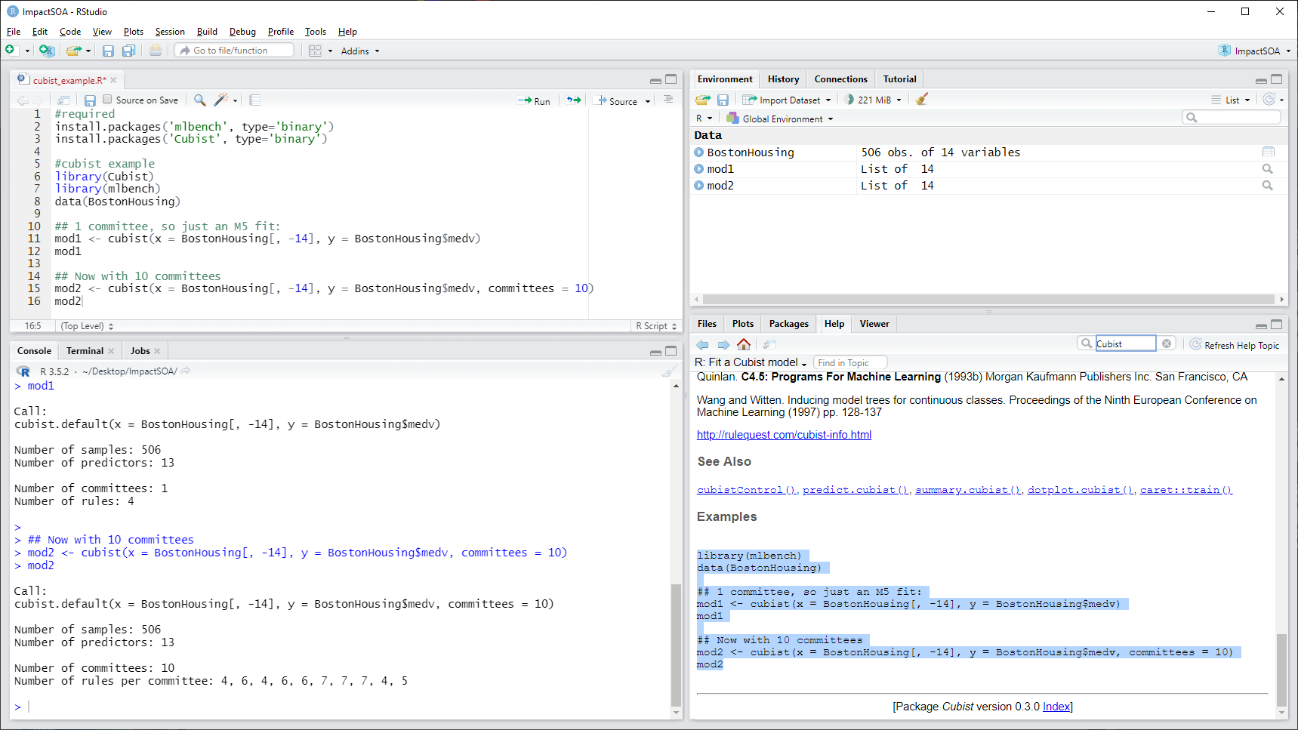



Slide 13

Diagram A
Diagram B
Desktop
Server
Memory
ODBC
C:\Users\username\Documents\R\R-3.5.2\library\mlbench\data\BostonHousing.rda
E:\Data_UserDB\ImpactSOA.mdf
Memory
Memory
Cubist
Cubist
Results
Results

Slide 14
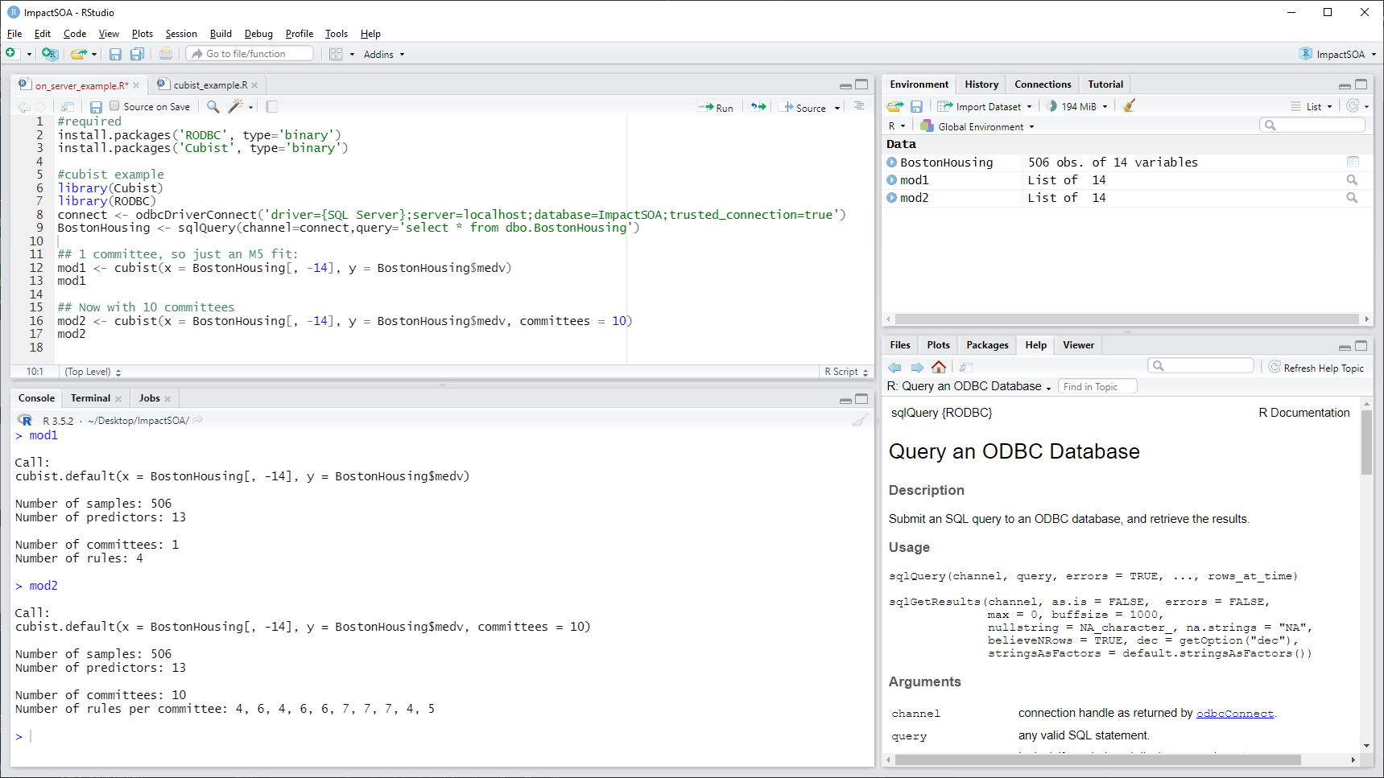

Slide 15
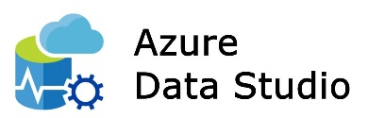
Diagram B
Diagram C
Server
Desktop
Memory
ODBC
SQL Server
Satellite
E:\Data_UserDB\ImpactSOA.mdf
Direct Communication
Memory
Cubist
Cubist
Launchpad
Results
Results

Slide 16
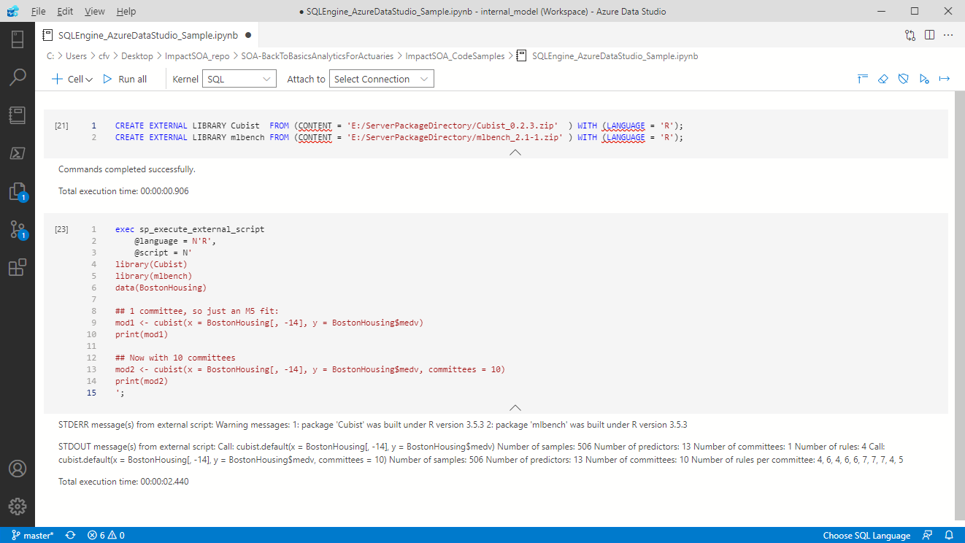

Slide 17
Resources Demo 1
https://github.com/hfleitas/AzureSynapseForActuaries/tree/main/CodeSamples
https://rstudio.com/products/rstudio/download
Reading data from Microsoft SQL Server into R - Stack Overflow
Install on Windows - SQL Server Machine Learning Services | Microsoft Docs
R language extension - SQL Server Machine Learning Services | Microsoft Docs
CREATE EXTERNAL LIBRARY (Transact-SQL) - SQL Server - SQL Server | Microsoft Docs

Slide 18
DEMO 2
Azure DevOps
Boards
Repos: enable more rapid actuarial development
Pipelines: maturing to CI/CD
Disclosure: Demo(s) are pre-recorded screenshots - a simulation.

Slide 19
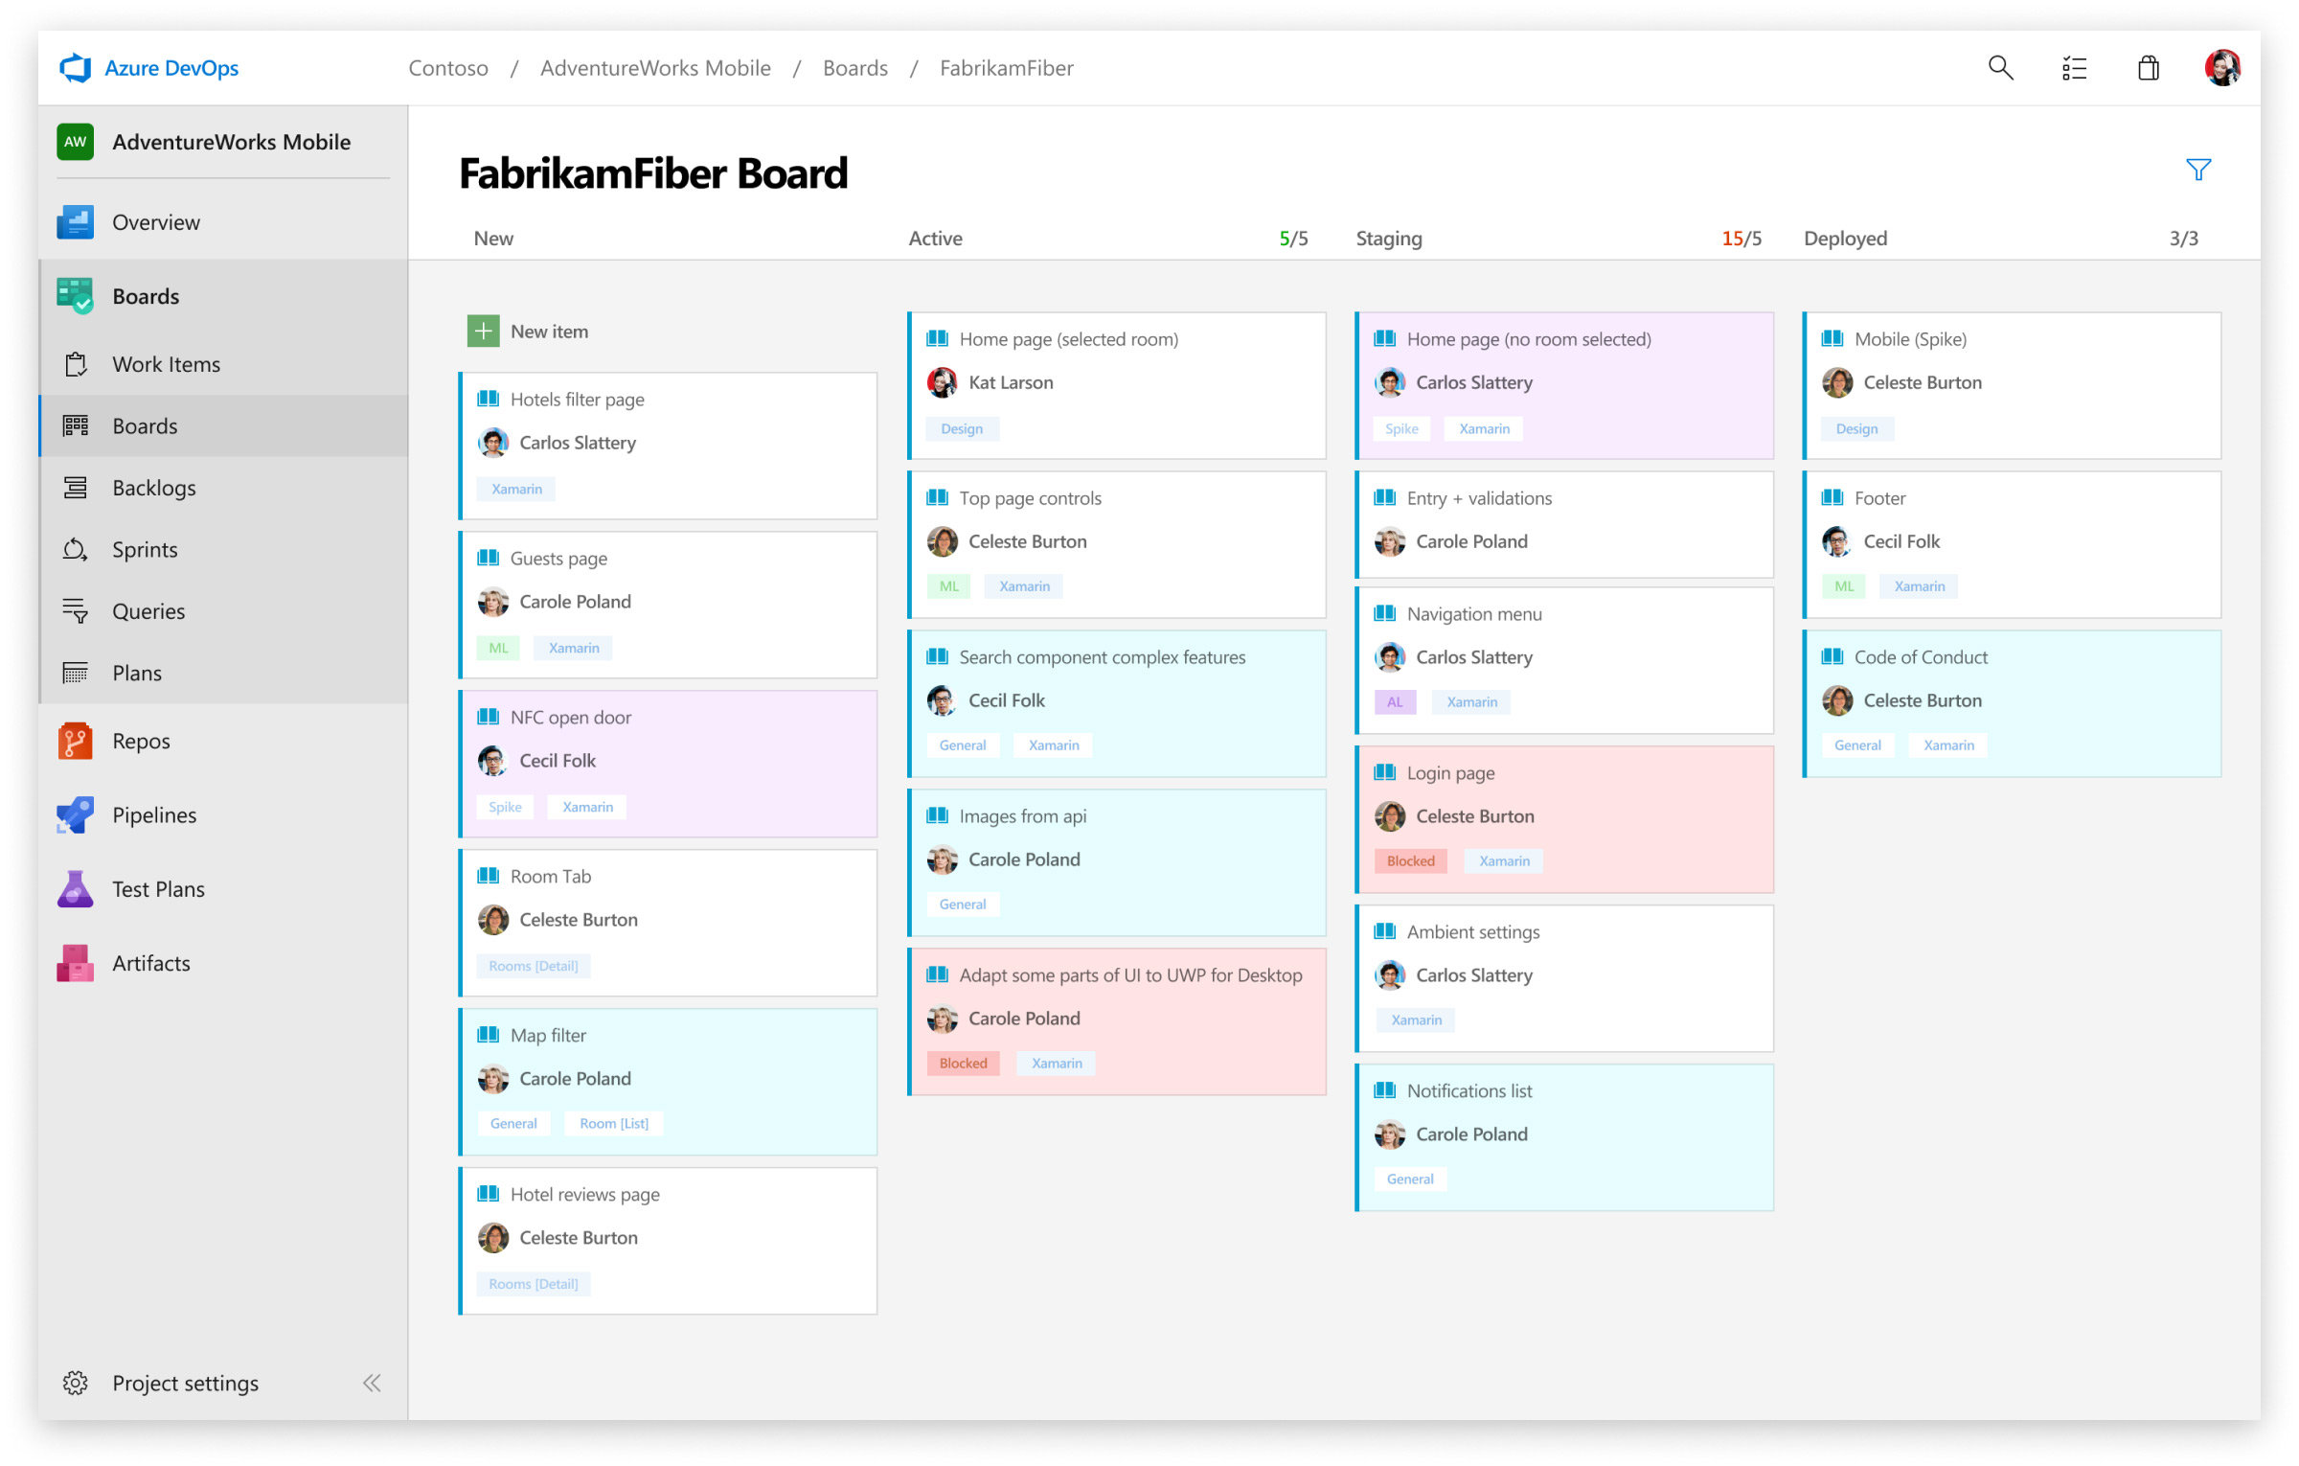

Slide 20
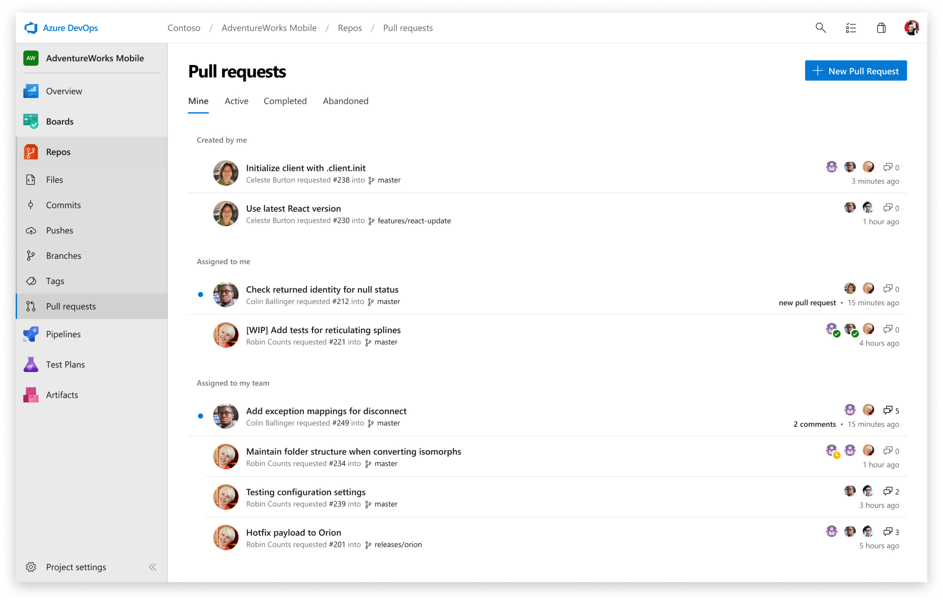

Slide 21
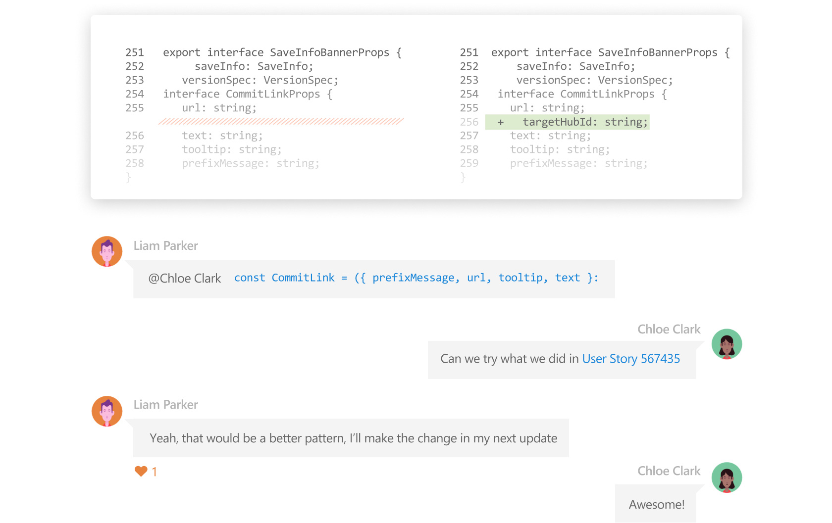

Slide 22
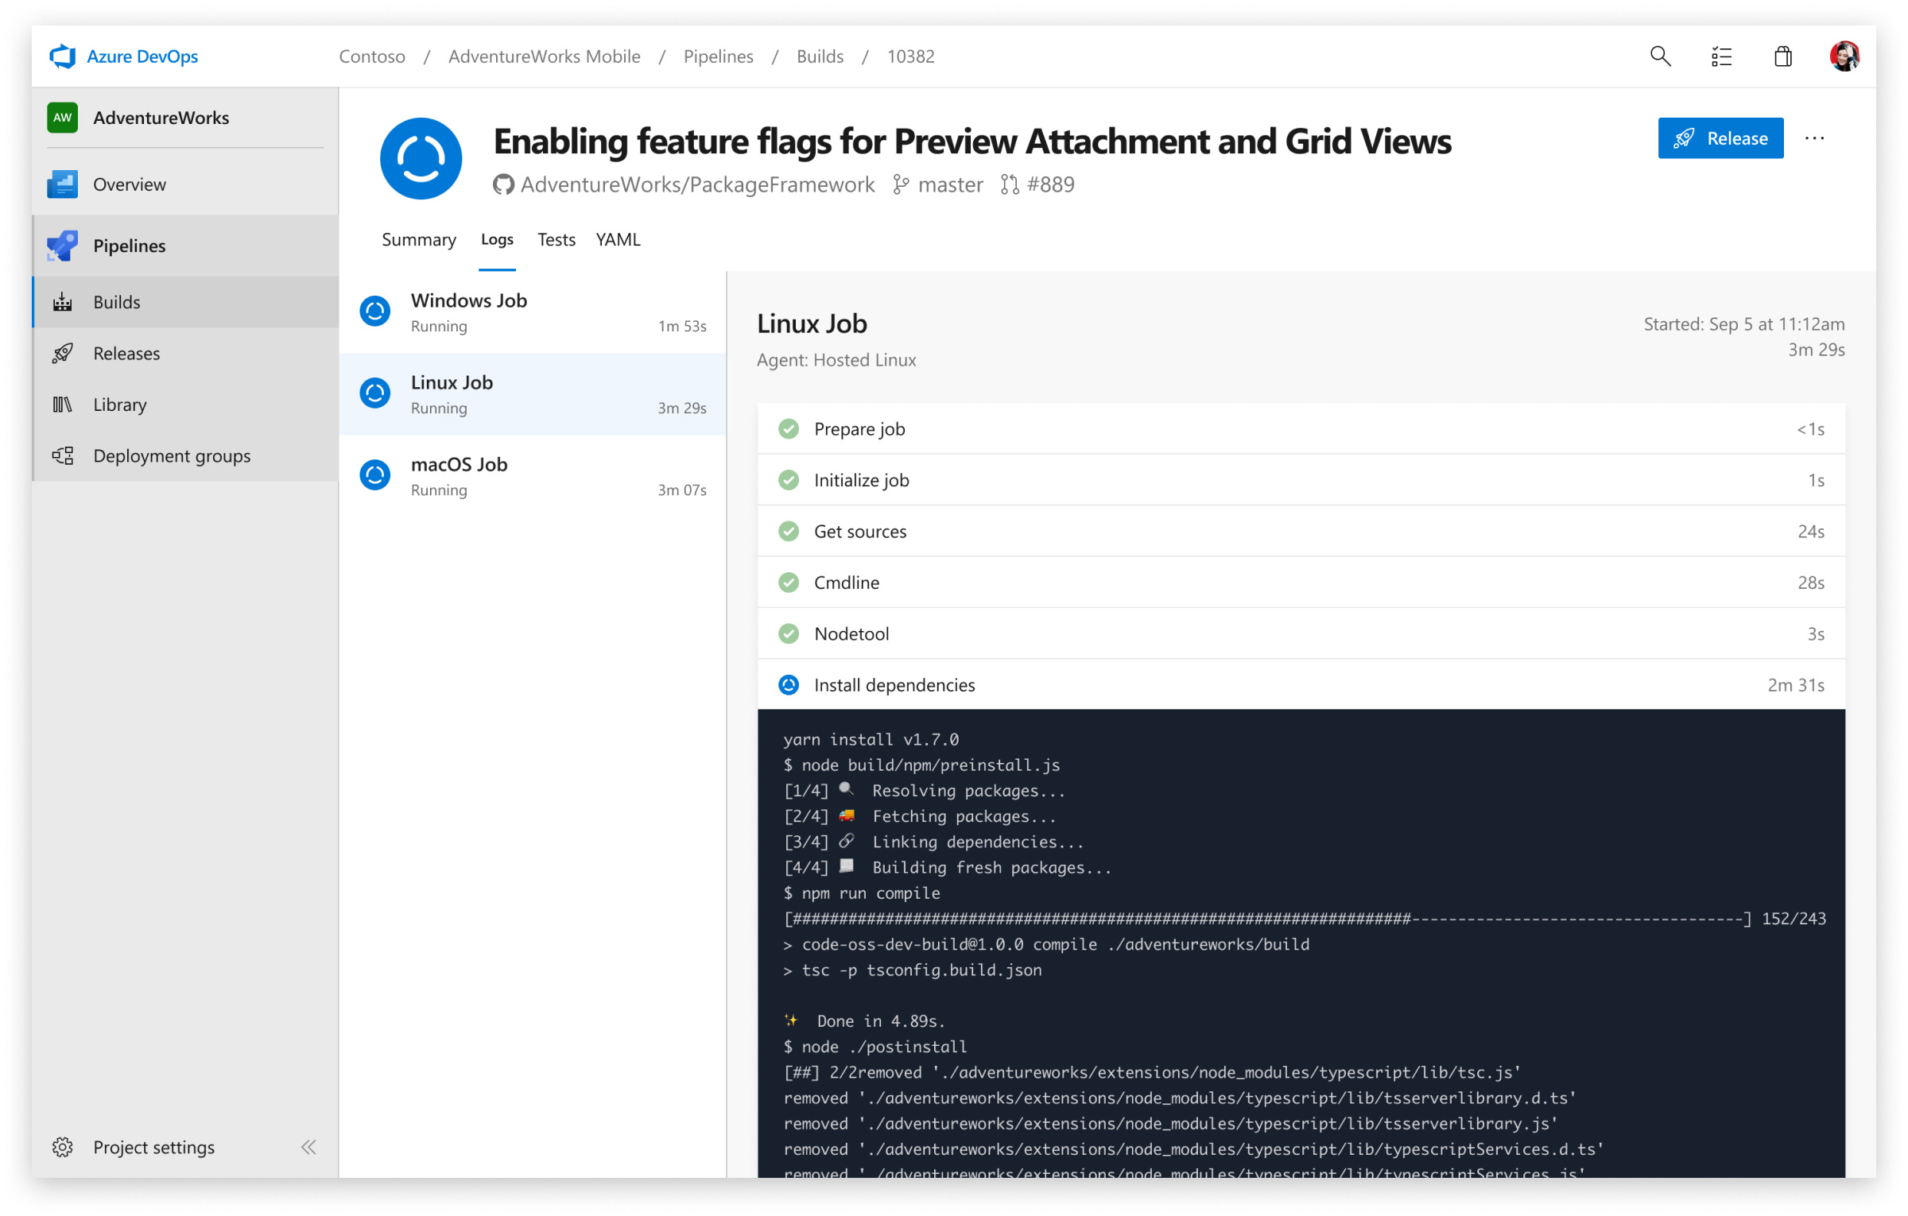

Slide 23
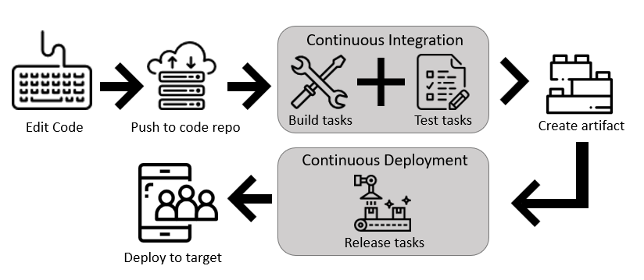
1
2
3
4
Ref: https://docs.microsoft.com/azure/devops/pipelines/get-started/pipelines-get-started

Slide 24
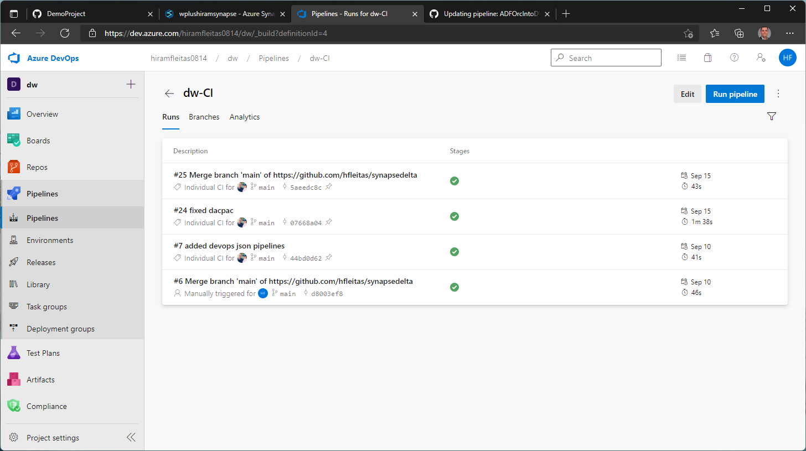


Slide 25
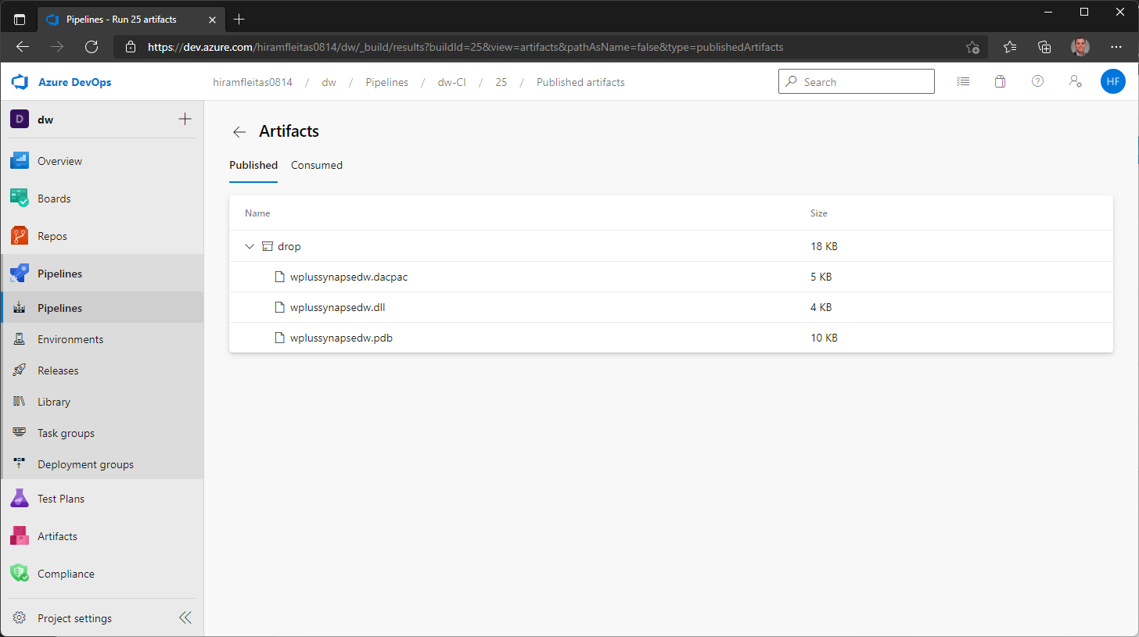


Slide 26
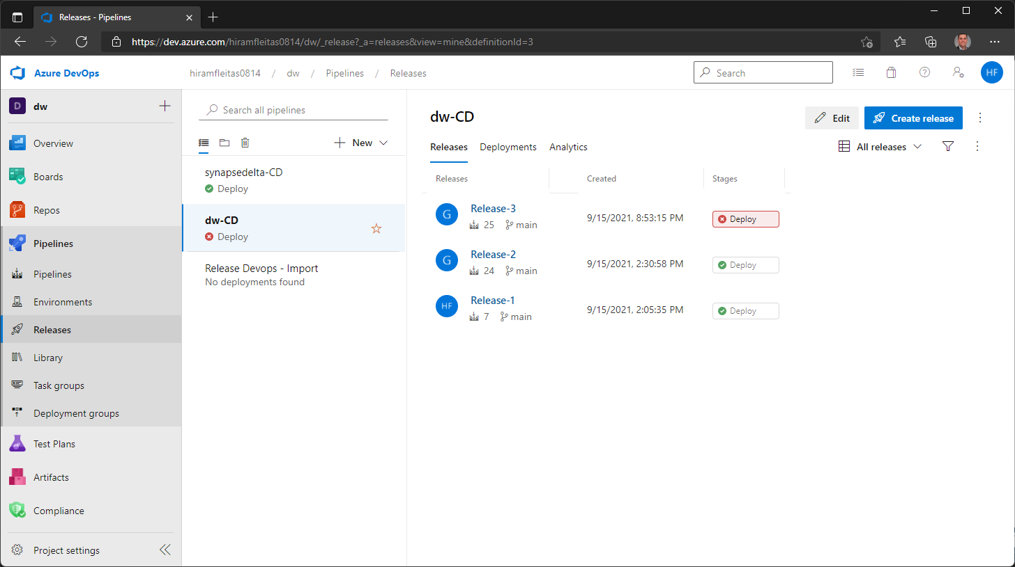

Slide 27
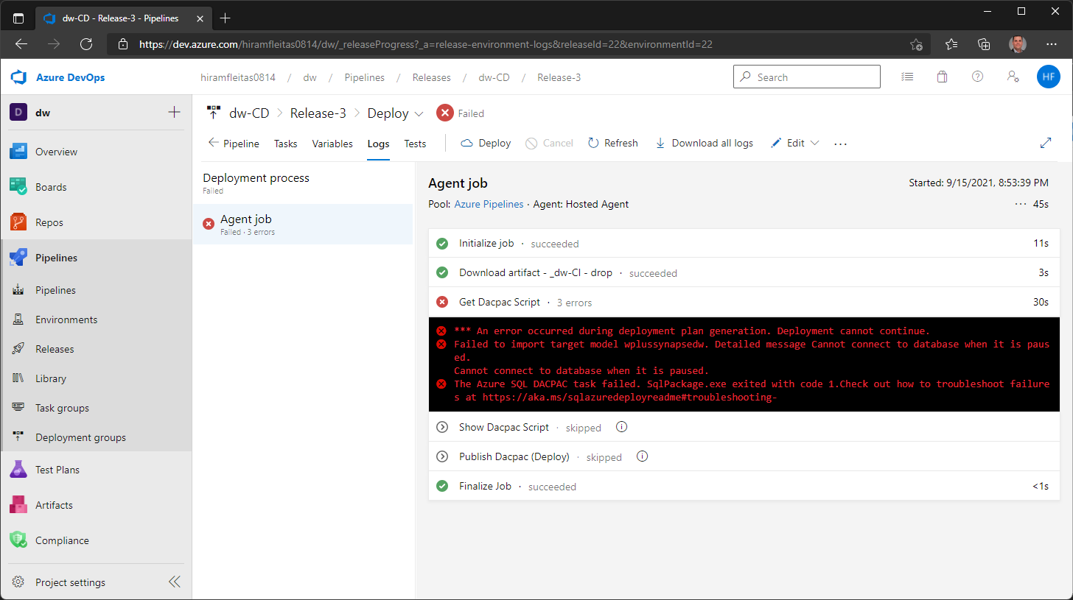

Slide 28
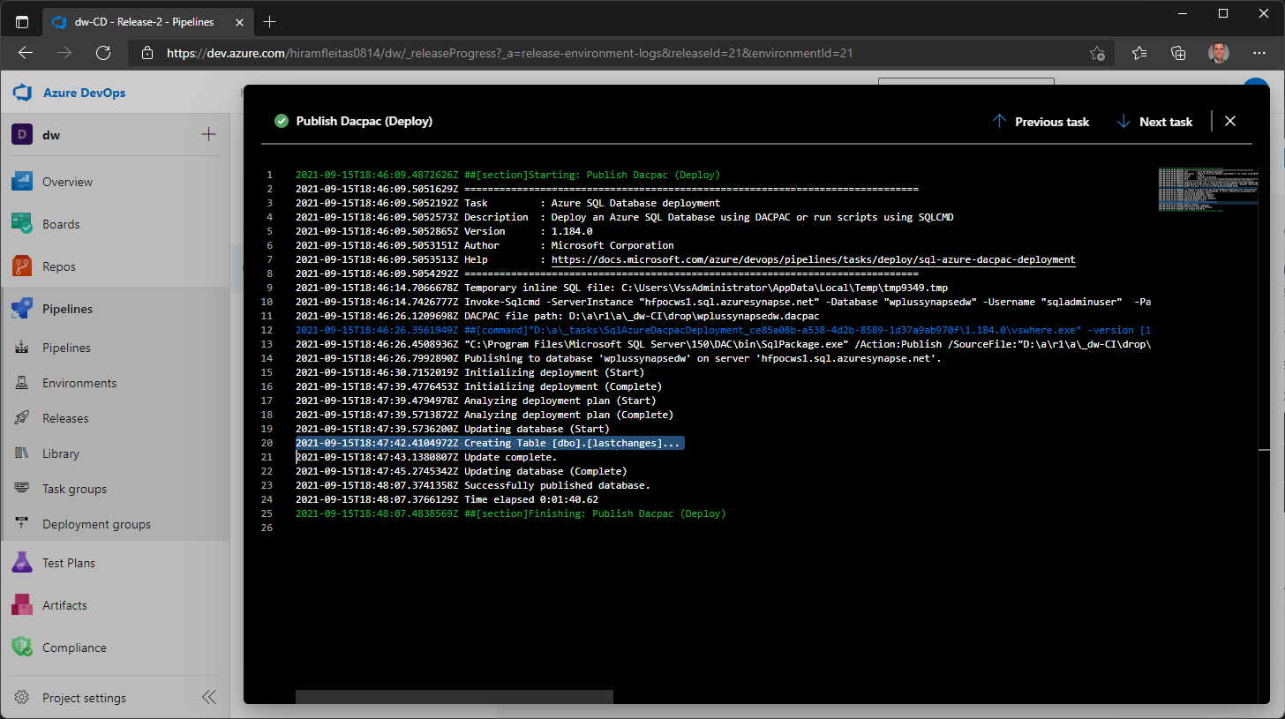

Slide 29
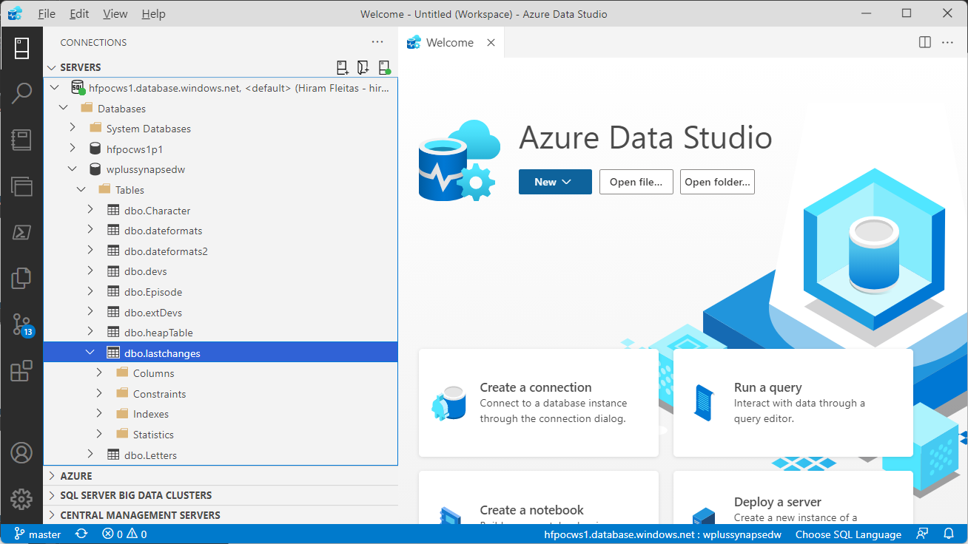

Slide 30
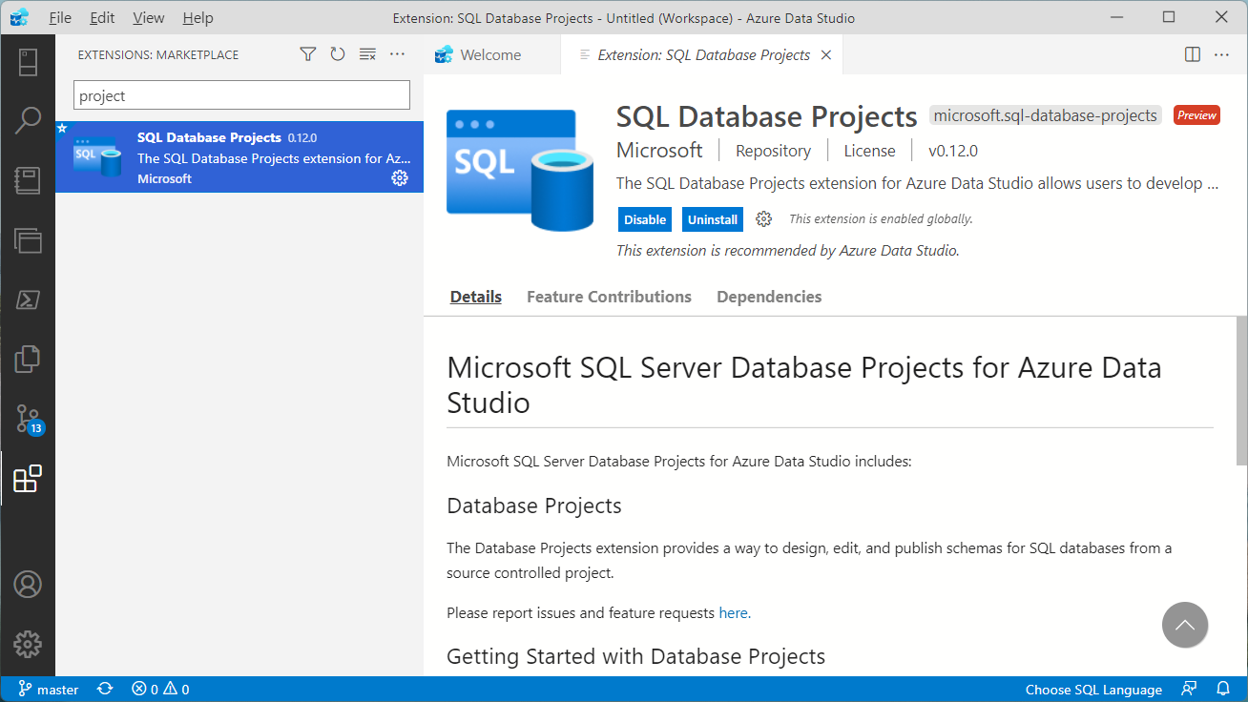

Slide 31
Resources Demo 2
Understand what you get with Azure Boards - Azure Boards | Microsoft Docs
Azure Boards | Microsoft Azure
About project boards - GitHub Docs
Azure Repos – Git Repositories | Microsoft Azure
Azure Pipelines | Microsoft Azure
https://microsoft.github.io/PartsUnlimited/iac/200.2x-IaC-CDAzureSQLdbwithVSTSandVS.html
https://docs.microsoft.com/azure/devops/pipelines/targets/azure-sqldb
https://docs.microsoft.com/sql/azure-data-studio/download-azure-data-studio

Slide 32
DEMO 3
Azure Synapse
Pipelines for Orchestrating Automation
Transformations: Data Flows (Spark in low-code)
Data movement: Including on-premises sources
Disclosure: Demo(s) are pre-recorded screenshots - a simulation.

Slide 33
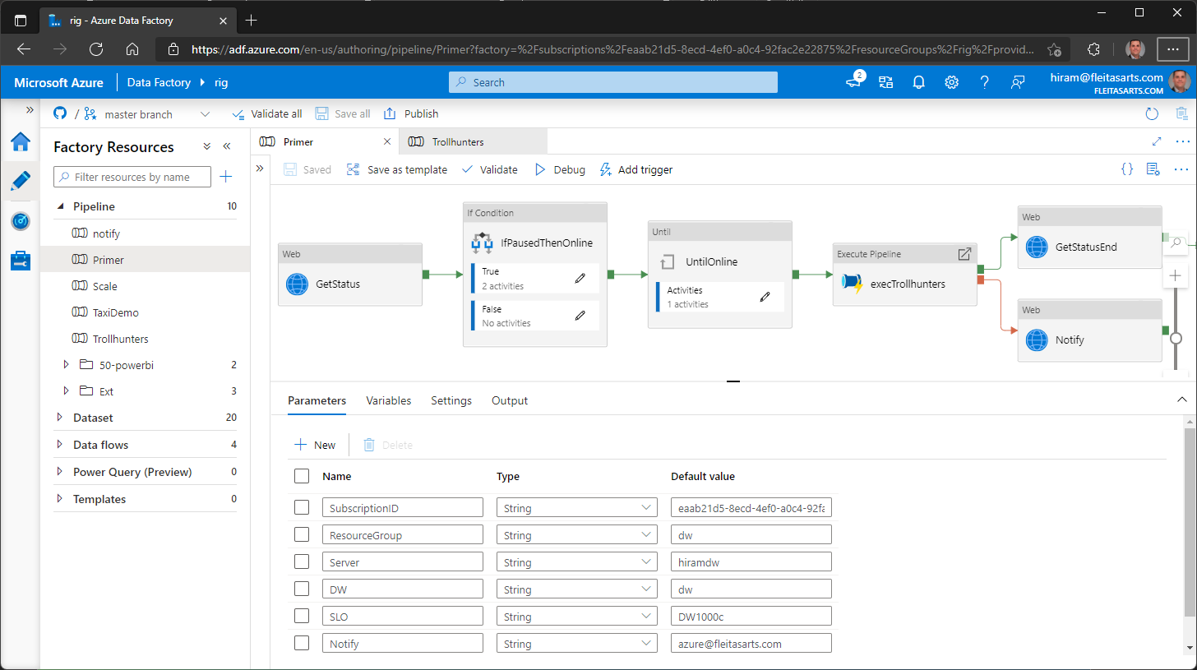

Slide 34
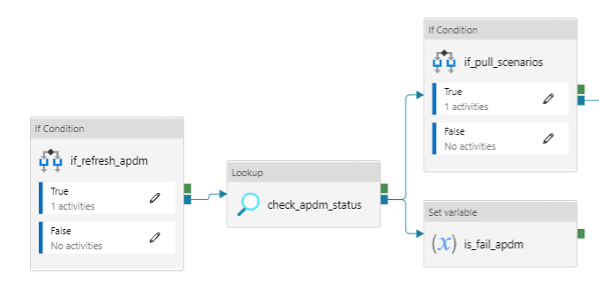
Pipeline: Publish Solvency II Model
Get X dataset for regression
Get Y dataset for regression
Do we have Y data?

Slide 35
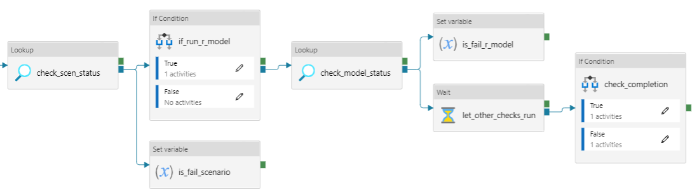
Cont’d
Run R regression models
Send status email.
Do we have X data?
Do we have regressions?

Slide 36
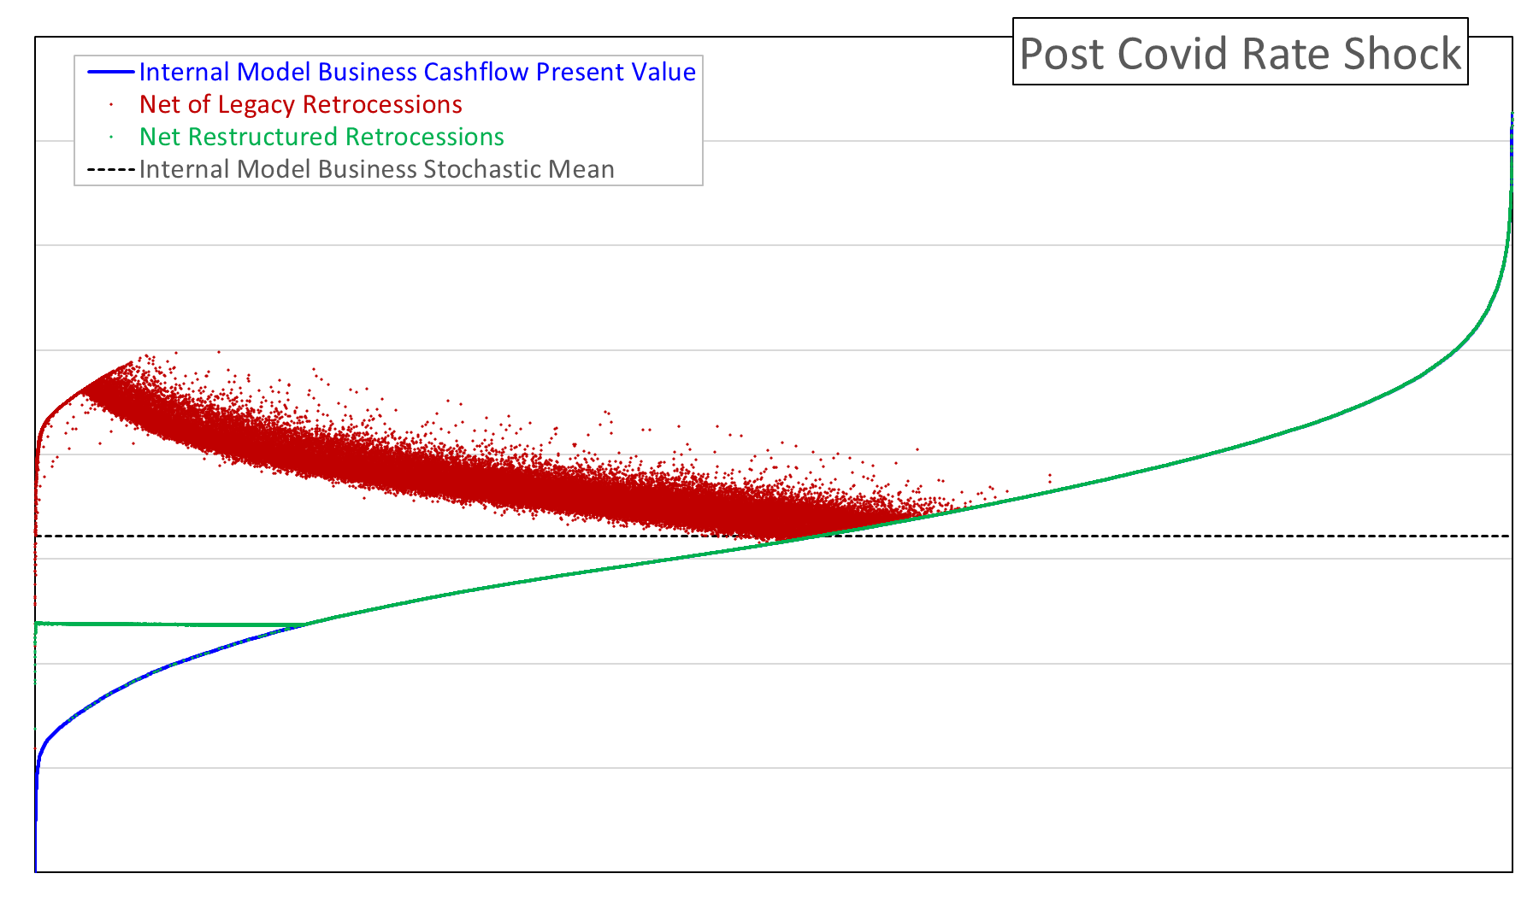
Solvency II Impact: Effective Responses

Slide 37
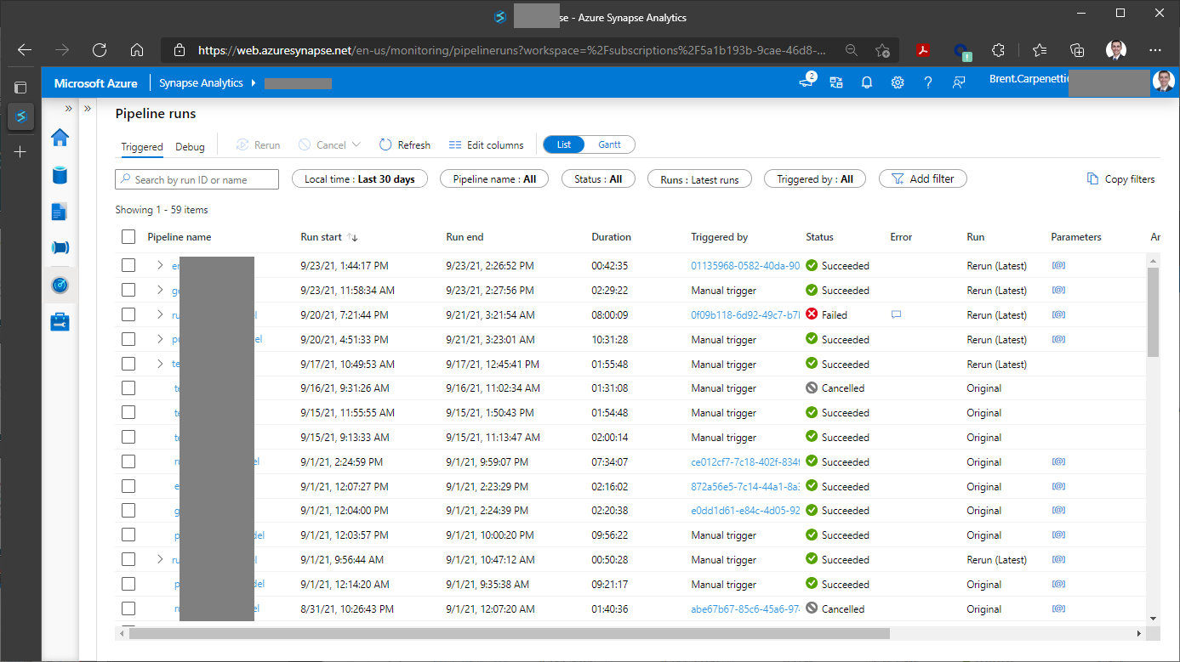

Slide 38
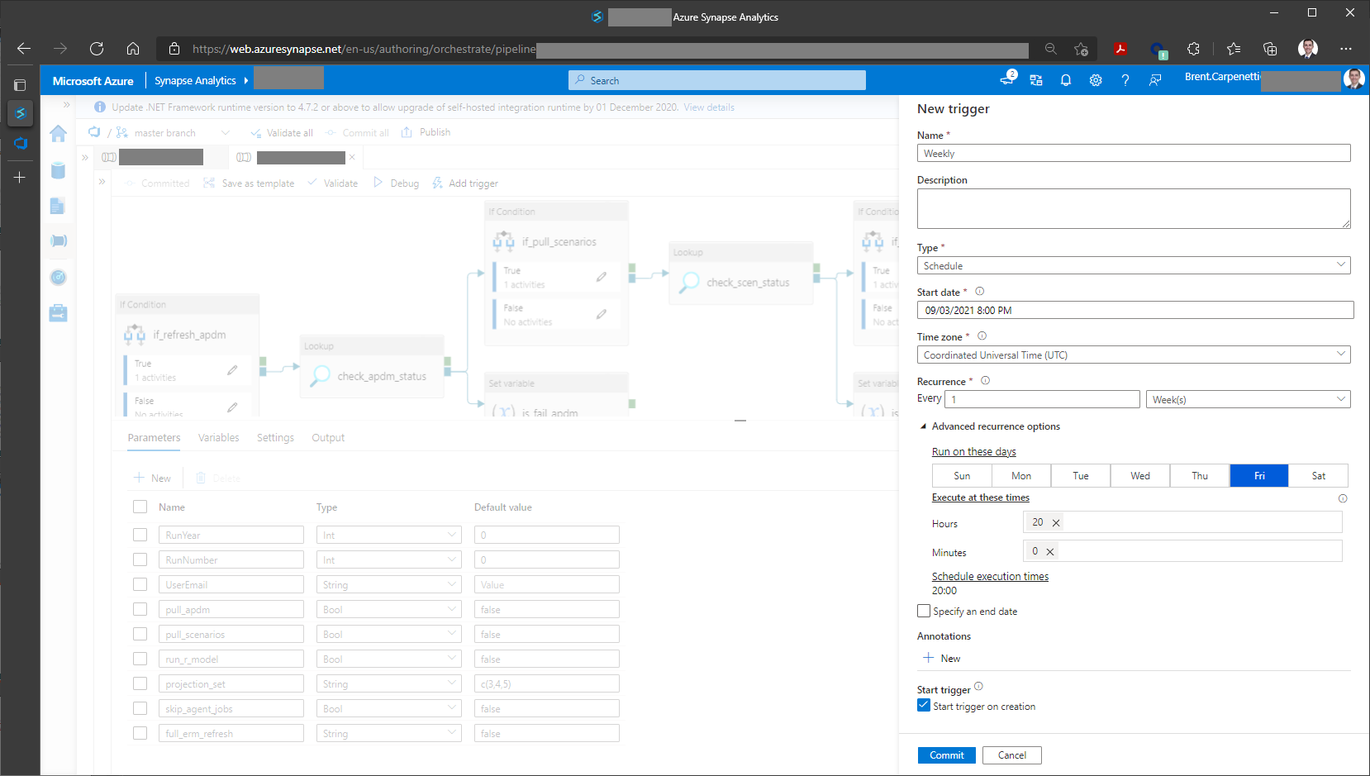

Slide 39
Tips and Tricks
Diagram your flow on a whiteboard before building the application
Identify what data elements are dimensions or facts early on
Sink/Stage/Write data at key process steps to create “checkpoints”
Normalize your data before running machine learning or regressions
Data science refers to this as data cleansing
Connect with IT and check if a data model already exists (it likely does!)
If you work on big data (Petabyte - structured/unstructured)
Consider defining unique, indexed, primary keys to improve join performance
Consider Spark compute resources (ADB/SynapseSpark) for transformations

Slide 40
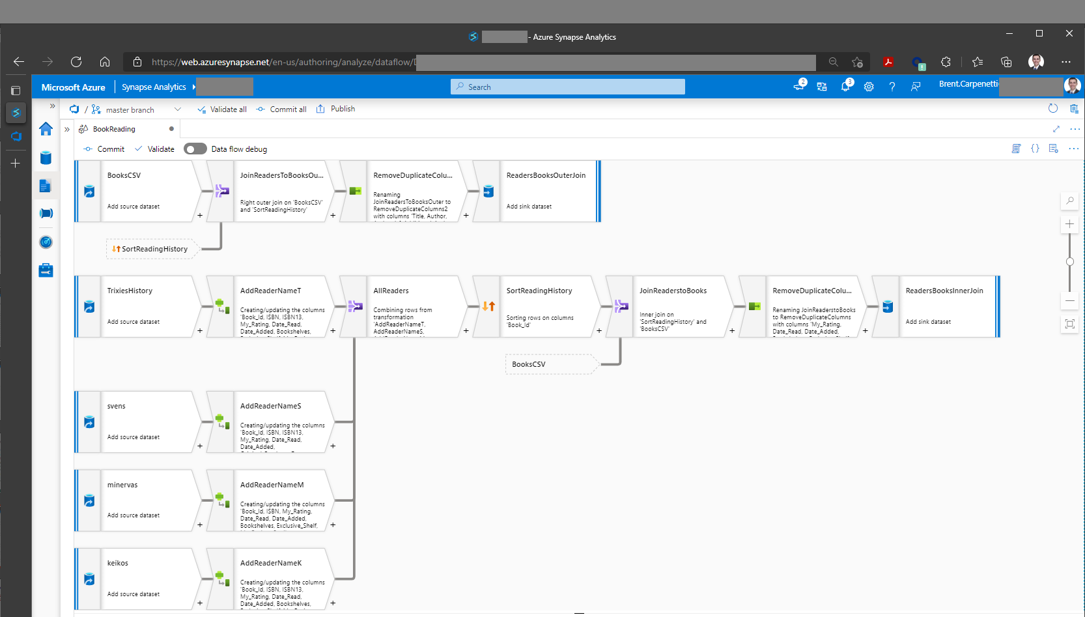

Slide 41
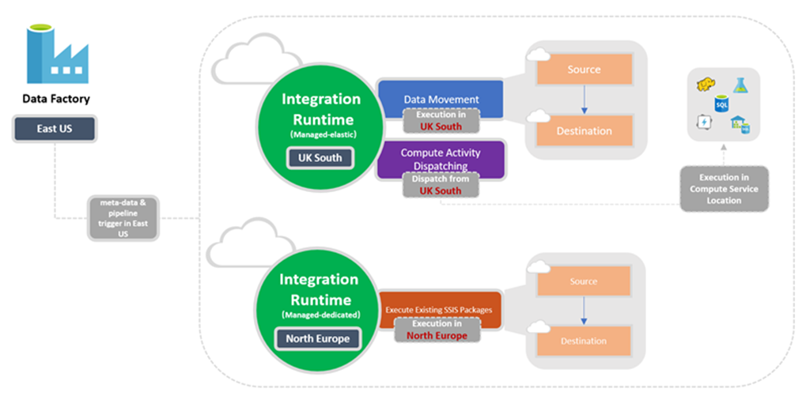

On-prem data centers
File Share
Orlando
Database
Orlando
Orlando
Database
Execute Stored Proc
Denver
Denver
Database

Slide 42
Resources Demo 3
https://github.com/hfleitas/rig/blob/master/pipeline/Primer.json
https://docs.microsoft.com/azure/data-factory/solution-templates-introduction
Azure Synapse Paths | Microsoft Learn
Data integration at scale with Azure Data Factory or Azure Synapse Pipeline
Use stored procedures - Azure Synapse Analytics | Microsoft Docs

Slide 43
BONUS
Azure Synapse
Data exploration
Notebook development
Server-less pools
Purview: Data Dictionary & Process Flows
Disclosure: Demo(s) are pre-recorded screenshots - a simulation.

Slide 44
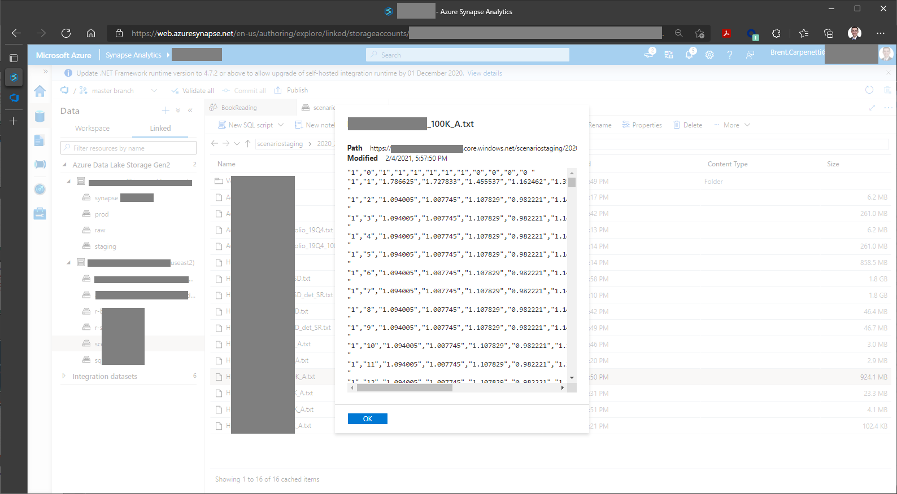

Slide 45
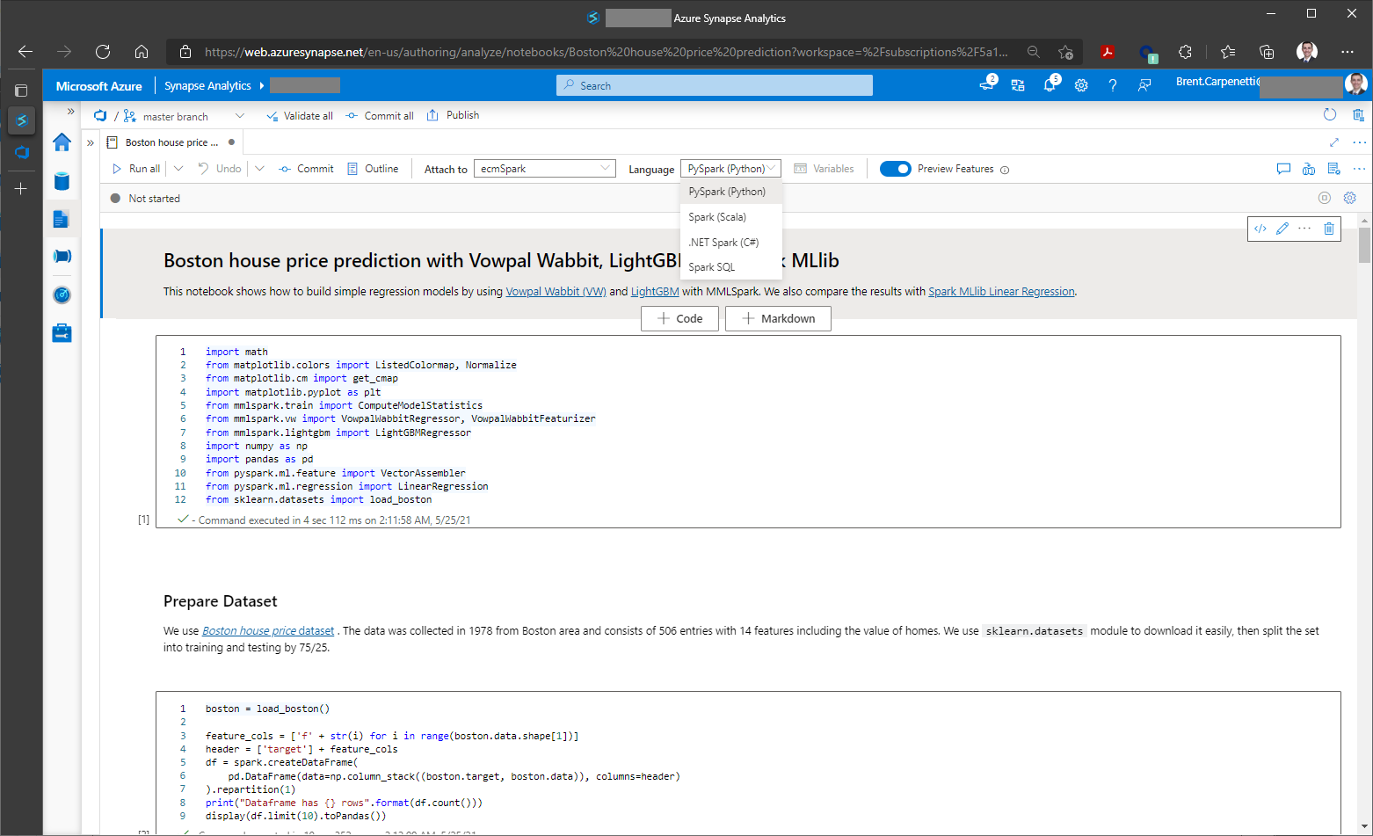

Slide 46
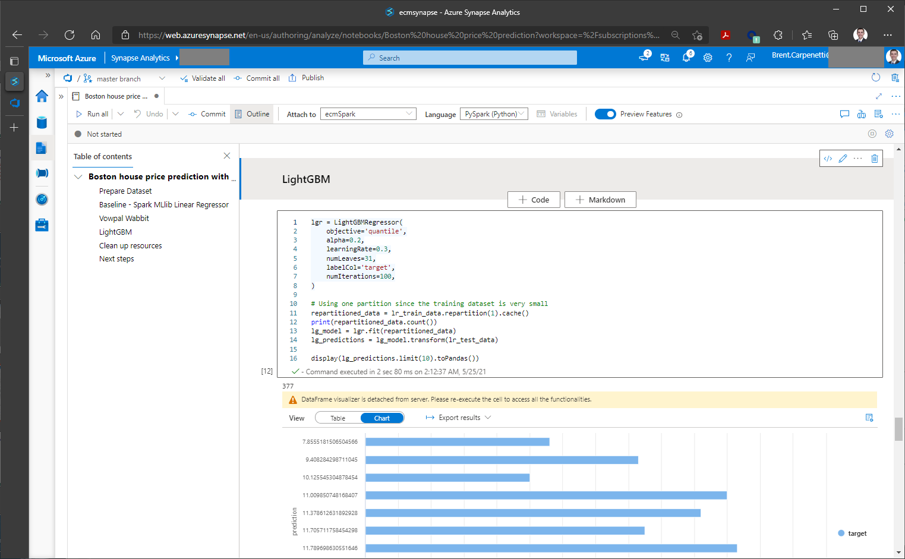

Slide 47
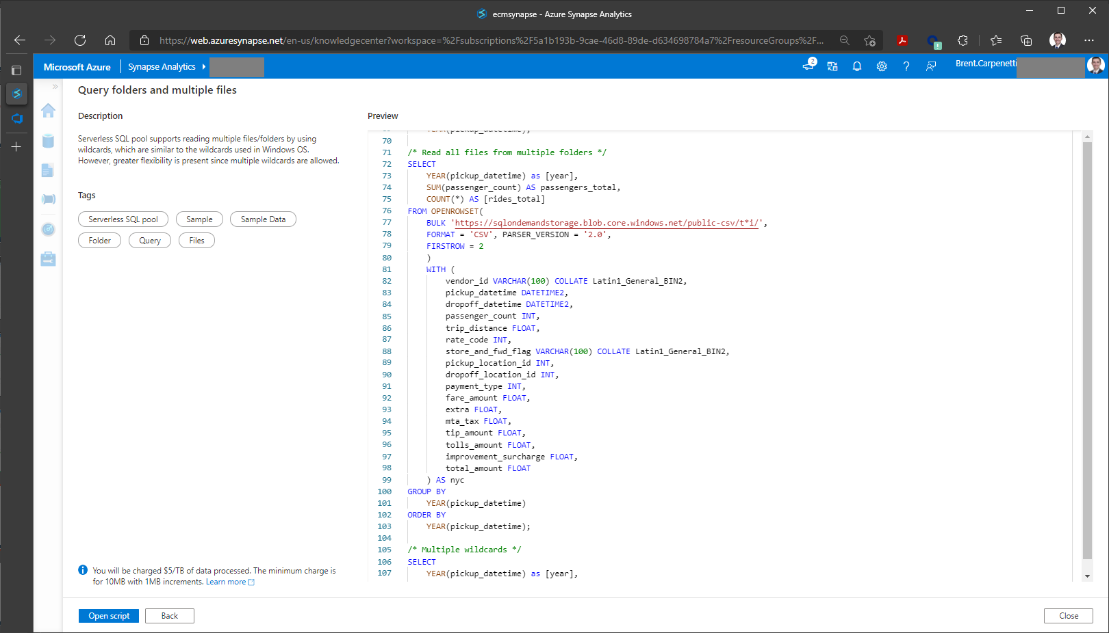

Slide 48
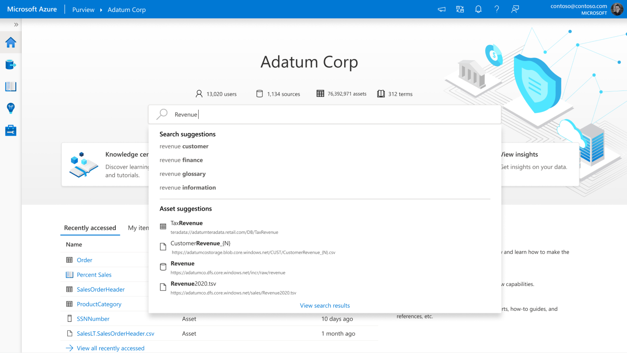

Slide 49
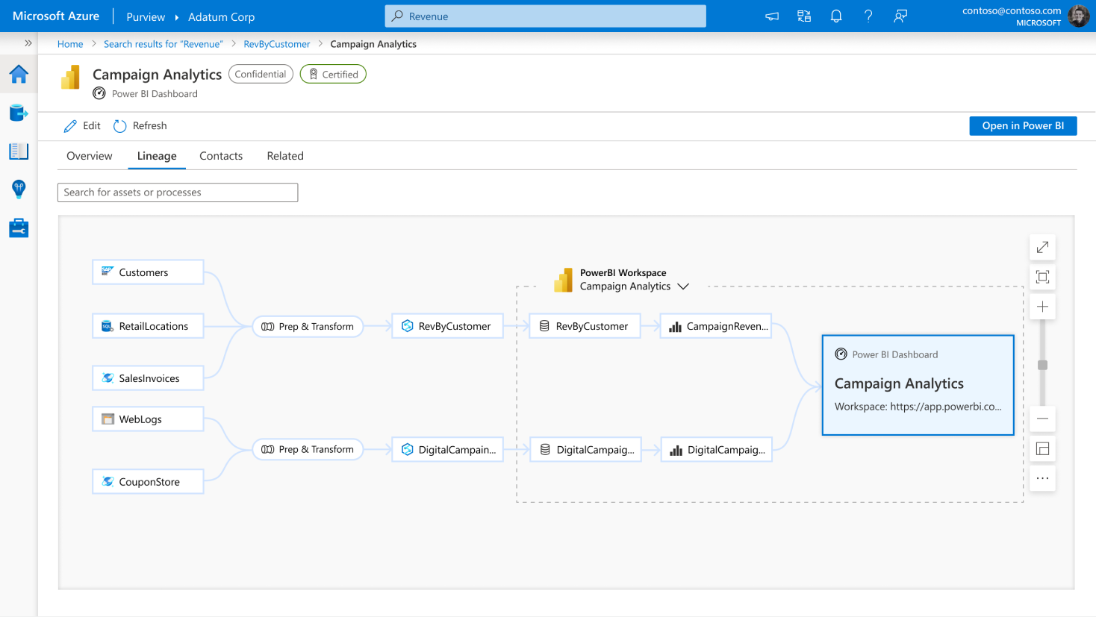

Slide 50
Summary
More intelligent R & SQL
Light intro to Azure DevOps
Quick overview of Synapse Pipelines (Data Factory)
Early Peaks at Azure Synapse

Slide 51

Fill Out the Evaluation and Claim Your CPD Credits

Slide 52
Thank you!
https://github.com/hfleitas/AzureSynapseForActuaries/blob/main/SolvencyIIUseCase.pdf
Presenters:
Brent Carpenetti; Senior Actuary, Hannover Re
Hiram Fleitas; Senior Customer Engineer, Microsoft
https://linkedin.com/in/brentcarpenetti
https://aka.ms/hiram

